Slide 1
Foundations of Cryptography collision resistance, second-preimage resistance, preimage resistance
LiangFeng Zhang
zhanglf@shanghaitech.edu.cn

Slide 2



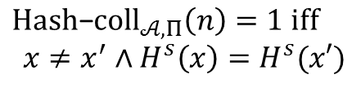


Collision Resistance
The Collision-Finding Experiment $Hash$-$coll_{𝒜,Π}(n)$:
$$s←Gen\left(1^{n}\right)$$
$$s$$
$$Challenger$$
$$Adversary 𝒜$$
$$x,x^{′}$$
$$Hash\text{−}coll_{𝒜,Π}\left(n\right)=1 iff$$
$$x≠x^{′}∧H^{s}\left(x\right)=H^{s}(x′)$$

Slide 3
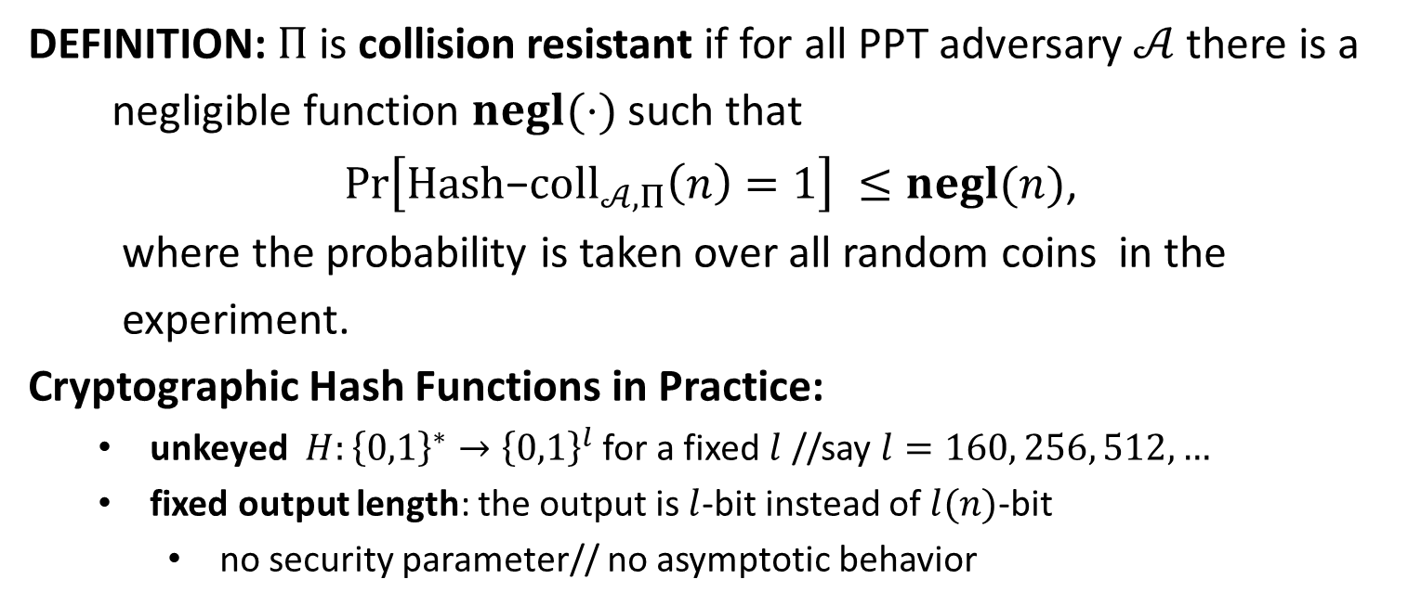
Collision Resistance
DEFINITION: $Π$is collision resistant if for all PPT adversary $𝒜$ there is a
negligible function $negl(⋅)$ such that
$\operatorname{Pr}\left[Hash\text{−}coll_{𝒜,Π}\left(n\right)=1\right] ≤negl(n)$,
where the probability is taken over all random coins in the
experiment.
Cryptographic Hash Functions in Practice:
unkeyed $H:{\left\{0,1\right\}}^{∗}→{\left\{0,1\right\}}^{l}$ for a fixed $l$ //say $l=160, 256, 512,…$
fixed output length: the output is $l$-bit instead of $l(n)$-bit
no security parameter// no asymptotic behavior

Slide 4



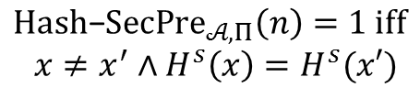
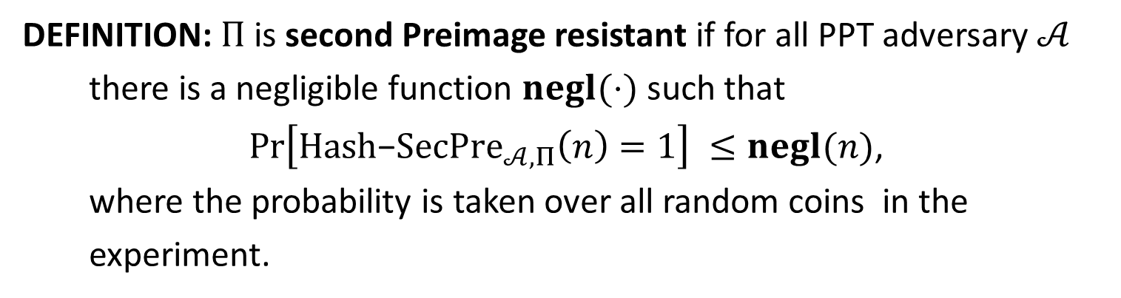


Second-Preimage Resistance
The Second Preimage-Finding Experiment $Hash$-$Sec{Pre}_{𝒜,Π}(n)$:
$$s←Gen\left(1^{n}\right)$$
$$x←{\left\{0,1\right\}}^{l^{′}(n)}$$
$$s,x$$
$$Challenger$$
$$Adversary 𝒜$$
$$x^{′}$$
$$Hash\text{−}SecPre_{𝒜,Π}\left(n\right)=1 iff$$
$$x≠x^{′}∧H^{s}\left(x\right)=H^{s}(x′)$$
DEFINITION: $Π$is second Preimage resistant if for all PPT adversary $𝒜$
there is a negligible function $negl(⋅)$ such that
$\operatorname{Pr}\left[Hash\text{−}SecPre_{𝒜,Π}\left(n\right)=1\right] ≤negl(n)$,
where the probability is taken over all random coins in the
experiment.

Slide 5



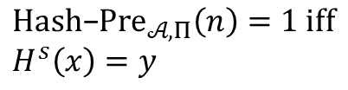
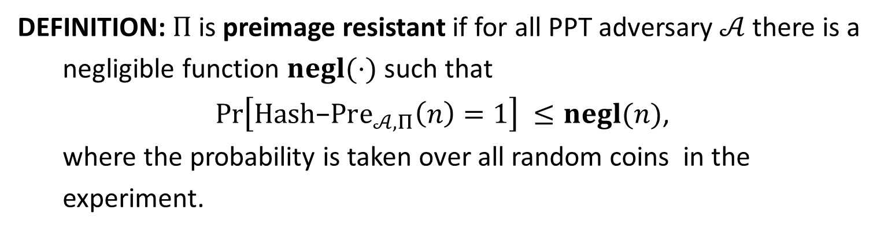
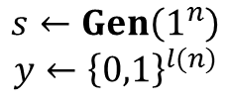

Preimage Resistance
The Preimage-Finding Experiment $Hash$-${Pre}_{𝒜,Π}(n)$:
$$s←Gen\left(1^{n}\right)$$
$$y←{\left\{0,1\right\}}^{l(n)}$$
$$s,y$$
$$Challenger$$
$$Adversary 𝒜$$
$$x$$
$$Hash\text{−}Pre_{𝒜,Π}\left(n\right)=1 iff$$
$$H^{s}\left(x\right)=y$$
DEFINITION: $Π$is preimage resistant if for all PPT adversary $𝒜$ there is a
negligible function $negl(⋅)$ such that
$\operatorname{Pr}\left[Hash\text{−}Pre_{𝒜,Π}\left(n\right)=1\right] ≤negl(n)$,
where the probability is taken over all random coins in the
experiment.

Slide 6
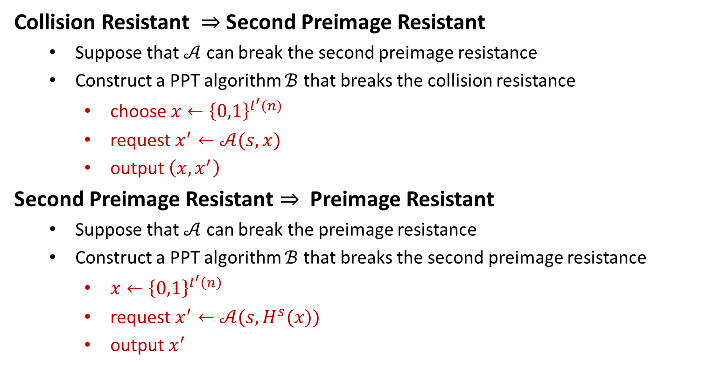
On the Security Levels
Collision Resistant $⇒$ Second Preimage Resistant
Suppose that $𝒜$ can break the second preimage resistance
Construct a PPT algorithm $ℬ$ that breaks the collision resistance
choose $x←{\left\{0,1\right\}}^{l^{′}(n)}$
request $x^{′}←𝒜(s,x)$
output $\left(x,x^{′}\right)$
Second Preimage Resistant $⇒$ Preimage Resistant
Suppose that $𝒜$ can break the preimage resistance
Construct a PPT algorithm $ℬ$ that breaks the second preimage resistance
$x←{\left\{0,1\right\}}^{l^{′}\left(n\right)}$
request $x^{′}←𝒜(s,H^{s}(x))$
output $x^{′}$

